Slide 1
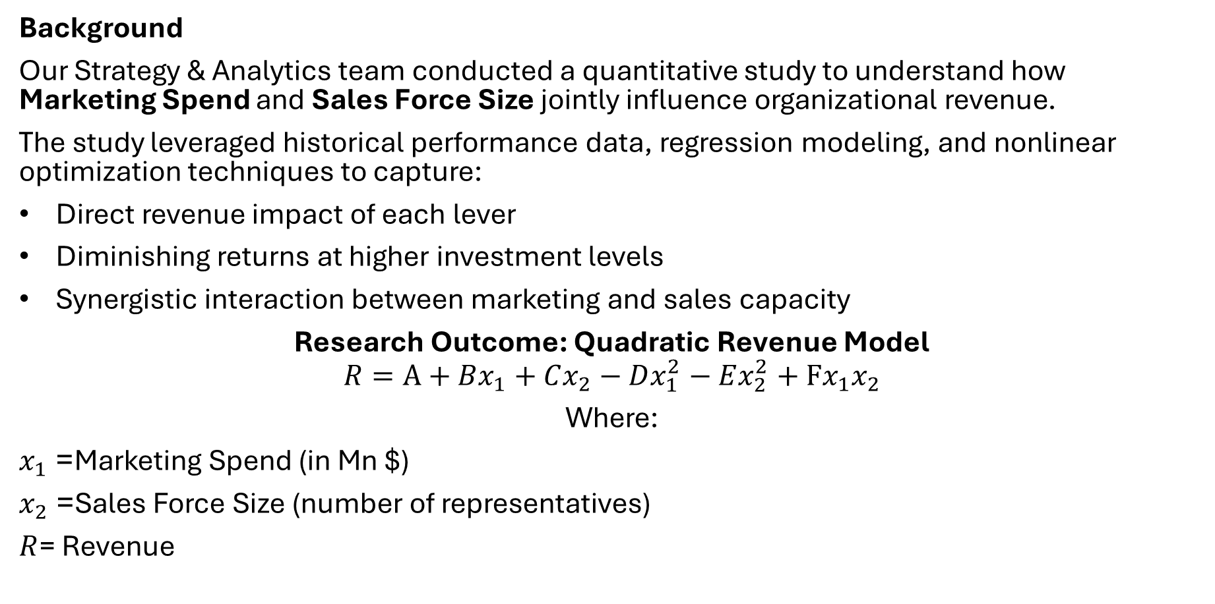
Research Overview & Revenue Model Outcome
Background
Our Strategy & Analytics team conducted a quantitative study to understand how Marketing Spend and Sales Force Size jointly influence organizational revenue.
The study leveraged historical performance data, regression modeling, and nonlinear optimization techniques to capture:
Direct revenue impact of each lever
Diminishing returns at higher investment levels
Synergistic interaction between marketing and sales capacity
Research Outcome: Quadratic Revenue Model
$$R=A+Bx_{1}+Cx_{2}−Dx_{1}^{2}−Ex_{2}^{2}+Fx_{1}x_{2}$$
Where:
$x_{1}$= Marketing Spend (in Mn $)
$x_{2}$= Sales Force Size (number of representatives)
$R$= Revenue

Slide 2
Key Findings
Revenue is non-linear and exhibits optimal investment levels.
Over-investment in either marketing or sales reduces marginal returns.
Joint optimization yields superior results versus isolated decision-making.
The interaction term confirms that marketing effectiveness increases when supported by adequate sales capacity.

